Slide 1
Memory Hierarchy
Muhammad Asim

Slide 2
Memory Hierarchy Design
Memory Hierarchy is an enhancement to organize the memory such that it can minimize the access time.
The Memory Hierarchy was developed based on a program behavior known as locality of references.
One key principle behind the development of the memory hierarchy is the locality of references exhibited by most computer programs. Locality of reference refers to the tendency of programs to access a relatively small subset of their total memory space at any given time.
There are two main types of locality:
Temporal locality, which refers to the tendency of a program to access the same memory locations repeatedly over a short period of time, and
Spatial locality, which refers to the tendency of a program to access memory locations that are close to each other in address space.

Slide 3
Memory Hierarchy Design
Memory hierarchy refers to the hierarchical arrangement of different types of memory in a computer system, each with varying characteristics such as capacity, speed, cost, and volatility. The purpose of the memory hierarchy is to provide a compromise between the conflicting requirements of speed and capacity, as well as cost-effectiveness.

Slide 4
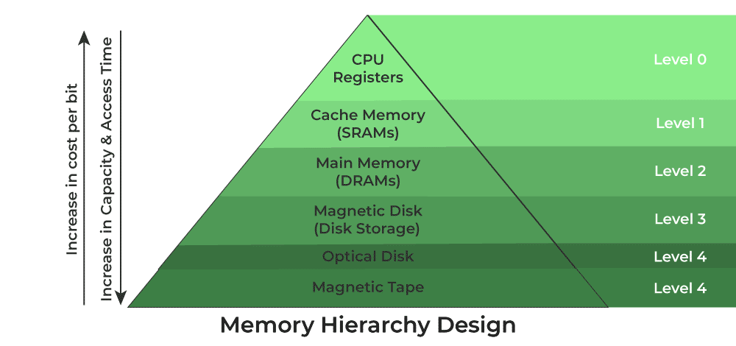
Types of Memory

Slide 5
Memory Hierarchy Design
Registers
Registers are the fastest and smallest type of memory in a computer system, located directly in the CPU. They hold data that is currently being processed by the CPU. Registers have extremely fast access times measured in nanoseconds. However, they are very limited in capacity, typically ranging from a few bytes to a few kilobytes.

Slide 6
Memory Hierarchy Design (contd..)
2. Cache Memory
Cache memory is the next level in the memory hierarchy and serves as a buffer between the CPU and main memory (RAM). It is designed to store copies of frequently accessed data and instructions to speed up CPU operations.
Cache memory is faster than main memory but slower than registers
There are typically multiple levels of cache memory (L1, L2, and sometimes L3), with each level being larger but slower than the previous one.

Slide 7
Levels of cache memory
L1 Cache (Level 1 Cache): This is the smallest and fastest cache memory directly integrated into the CPU core. It is used to store frequently accessed data and instructions, providing the fastest access times but limited capacity.
L2 Cache (Level 2 Cache): L2 cache is larger in size but slower than L1 cache. It is typically located on the same chip as the CPU or in close proximity to it. L2 cache serves as a secondary cache, storing additional frequently accessed data that cannot fit in the L1 cache.
L3 Cache (Level 3 Cache): L3 cache, if present, is larger but slower than both L1 and L2 caches. It is usually shared among multiple CPU cores within a processor or across the entire CPU socket. L3 cache acts as a last-level cache, providing storage for data that is less frequently accessed but still needs to be readily available.

Slide 8
Memory Hierarchy Design (contd..)
3. Main Memory
Main memory, or Random Access Memory, is the primary storage area in a computer system. It holds data and instructions that are actively being used by the CPU. Main memory is slower than cache memory but offers significantly larger capacity. Access times are measured in nanoseconds to tens of nanoseconds.
Types of Main Memory
Static RAM
Dynamic RAM

Slide 9
The types of main memory are:
1. Static RAM (SRAM):
Static RAM (SRAM) is a type of main memory that is one of the fastest and most important forms of main memory. The key characteristic of SRAM is that it retains its information without the need for any refreshing or updating, which contributes to its high speed. It is commonly used as cache memory.
2. Dynamic RAM (DRAM):
Dynamic RAM (DRAM) is another type of main memory that is more common but less performance compared to SRAM. The important characteristic of DRAM is that its information needs to be refreshed or updated continuously to maintain its stability. DRAM is typically used as primary memory.

Slide 10
Memory Hierarchy Design (contd..)
4. Secondary Storage
Secondary storage devices, such as hard disk drives (HDDs), solid-state drives (SSDs), and optical disks, provide long-term storage for data and programs. Unlike main memory, secondary storage is non-volatile, meaning it retains data even when the power is turned off. However, it is much slower than main memory, with access times typically measured in milliseconds.
Types of secondary Memory
Hard Disk Drives (HDDs): HDDs store data on rotating magnetic disks called platters. They offer high capacity at relatively low cost but have slower access times compared to SSDs.
Solid-State Drives (SSDs): SSDs use flash memory to store data, offering faster access times and better reliability than HDDs. However, they are typically more expensive and have lower capacities.

Slide 11
Characteristics of Memory Hierarchy
Capacity: It is the global volume of information the memory can store. As we move from top to bottom in the Hierarchy, the capacity increases.
Access Time: It is the time interval between the read/write request and the availability of the data.
Performance: Earlier when the computer system was designed without a Memory Hierarchy design, the speed gap increased between the CPU registers and Main Memory due to a large difference in access time.
Cost Per Bit: As we move from bottom to top in the Hierarchy, the cost per bit increases i.e. Internal Memory is costlier than External Memory.

